Slide 1


Gabrirel Shamon
13-03-2025

Slide 2

Outline
Executive Summary
Introduction
Methodology
Results
Conclusion
Appendix

Slide 3
Executive Summary
Summary of methodologies
Summary of all results

Slide 4
Introduction
he project involves analyzing SpaceX launch data to discover geographical patterns and factors that may influence the success rates of launches using interactive visual analytics with Folium and machine learning models.
Problems we want answers for:
Are launch sites in close proximity to the Equator and coastlines?
Do launch sites have higher success rates based on their geographical locations?
Is there a relationship between flight number and launch site success?
How does payload mass affect the success rate of launches at different sites?
Which orbit types have the highest success rates?
How does the success rate of launches vary over the years?

Slide 5

Section 1

Slide 6
Methodology
Executive Summary
Data collection methodology:
The data was collected using the SpaceX API by making GET requests to retrieve information about past launches.
Perform data wrangling
The data was processed by cleaning, filtering, and transforming it to include only relevant information, handling missing values, and creating new features for analysis.
Perform exploratory data analysis (EDA) using visualization and SQL
Perform interactive visual analytics using Folium and Plotly Dash
Perform predictive analysis using classification models
How to build, tune, evaluate classification models

Slide 7
Data Collection
The data sets for the SpaceX project were collected from various sources and processed through several steps to ensure they were ready for analysis. Below is a description of the data collection process using key phrases and a flowchart.
Key Phrases:
Data Sources: SpaceX API, CSV files from IBM Cloud Object Storage.
Data Extraction: API calls, CSV file downloads.
Data Cleaning: Handling missing values, data type conversions.
Data Integration: Merging multiple data sources.
Data Storage: Storing cleaned and integrated data in Pandas DataFrames.
graph TD;
A[Data Sources] -->|API Calls| B[SpaceX API]
A[Data Sources] -->|CSV Downloads| C[IBM Cloud Object Storage]
B --> D[Data Extraction]
C --> D[Data Extraction]
D --> E[Data Cleaning]
E --> F[Data Integration]
F --> G[Data Storage in Pandas DataFrames]

Slide 8
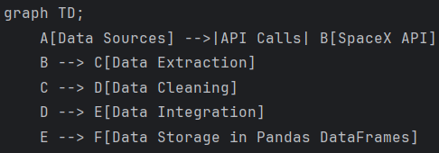
Data Collection – SpaceX API
The data collection process for the SpaceX project involves making REST API calls to the SpaceX API to gather relevant data about rocket launches. Below is a description of the data collection process using key phrases and a flowchart.
IBM-Data-Science/spaceX/jupyter-labs-spacex-data-collection-api-v2.ipynb at main · gp2001/IBM-Data-Science

Slide 9
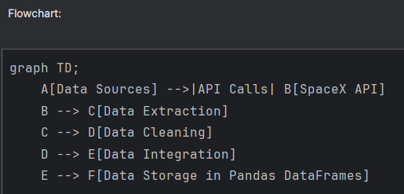
Data Collection - Scraping
Data Collection Process with SpaceX REST Calls
* Data Sources: SpaceX API.
Data Extraction: API calls to retrieve launch data.
Data Cleaning: Handling missing values, data type conversions.
Data Integration: Combining data from multiple API endpoints.
Data Storage: Storing cleaned and integrated data in Pandas DataFrames.
IBM-Data-Science/spaceX/jupyter-labs-spacex-data-collection-api-v2.ipynb at main · gp2001/IBM-Data-Science

Slide 10
Data Wrangling
The data wrangling process involves cleaning, transforming, and organizing raw data into a usable format for analysis. Below is a description of the data wrangling process using key phrases and a flowchart.
Data Cleaning: Removing rows with multiple cores and payloads, handling missing values.
Data Transformation: Converting date columns to datetime, extracting specific values from lists.
Feature Extraction: Extracting relevant features from columns such as rocket, payload, launchpad, and cores.
Data Integration: Combining extracted features into a single DataFrame.
Data Filtering: Filtering data to include only Falcon 9 launches.
Handling Missing Values: Replacing missing values in PayloadMass with the mean.
Export Data: Saving the cleaned and processed data to a CSV file.
Add the GitHub URL of your completed data wrangling related notebooks, as an external reference and peer-review purpose
IBM-Data-Science/spaceX/labs-jupyter-spacex-Data wrangling-v2.ipynb at main · gp2001/IBM-Data-Science

Slide 11
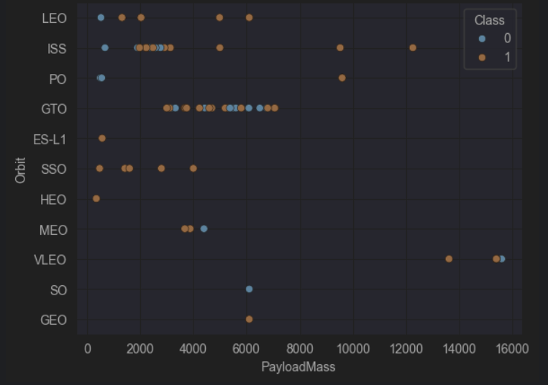
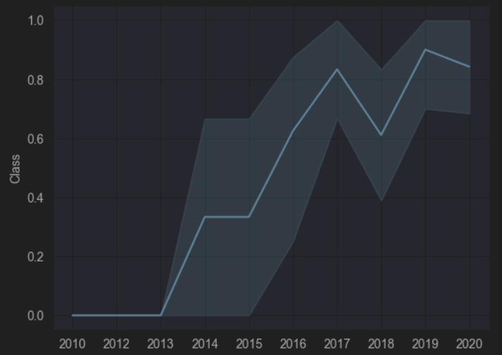
EDA with Data Visualization
The data visualization process involves analyzing the relationship between various factors affecting the success of SpaceX Falcon 9 launches. Key visualizations include the relationship between flight number and payload mass, launch site, and orbit type, as well as the yearly success rate trend. These visualizations help identify patterns such as higher success rates with increased flight numbers, varying success rates across different launch sites and orbits, and an overall increase in success rates over time.
IBM-Data-Science/spaceX/jupyter-labs-eda-dataviz-v2.ipynb at main · gp2001/IBM-Data-Science

Slide 12
EDA with SQL
IBM-Data-Science/spaceX/jupyter-labs-eda-sql-coursera_sqllite.ipynb at main · gp2001/IBM-Data-Science
Task 1: Display the names of the unique launch sites in the space mission.
Task 2: Display 5 records where launch sites begin with the string 'CCA'.
Task 3: Display the total payload mass carried by boosters launched by NASA (CRS).
Task 4: Display average payload mass carried by booster version F9 v1.1.
Task 5: List the date when the first successful landing outcome in ground pad was achieved.
Task 6: List the names of the boosters which have success in drone ship and have payload mass greater than 4000 but less than 6000.
Task 7: List the total number of successful and failure mission outcomes.
Task 8: List the names of the booster versions which have carried the maximum payload mass using a subquery.
Task 9: List the records which display the month names, failure landing outcomes in drone ship, booster versions, and launch site for the months in the year 2015.
Task 10: Rank the count of landing outcomes (such as Failure (drone ship) or Success (ground pad)) between the date 2010-06-04 and 2017-03-20, in descending order.

Slide 13
Build an Interactive Map with Folium
Summary of Map Objects Created and Added to a Folium Map
Markers:
Launch Sites: Added markers to indicate the locations of all SpaceX launch sites.
Success/Failure Launches: Added markers to show the outcomes of each launch (green for success, red for failure).
Circles:
Launch Sites: Added circles around each launch site to highlight their locations.
Lines:
Distance Lines: Added lines to show the distances between launch sites and their proximities (e.g., coastlines, cities).
Reasons for Adding These Objects
Markers: To visually pinpoint the exact locations of launch sites and to differentiate between successful and failed launches.
Circles: To provide a visual emphasis on the launch sites, making them easier to locate on the map.
Lines: To illustrate the geographical relationships and distances between launch sites and nearby points of interest, aiding in spatial analysis.
IBM-Data-Science/spaceX/lab_jupyter_launch_site_location.jupyterlite.ipynb at main · gp2001/IBM-Data-Science

Slide 14
Build a Dashboard with Plotly Dash
Summary of Plots/Graphs and Interactions Added to the Dashboard
Pie Chart: Displays the total successful launches count for all sites or the success vs. failure counts for a selected site. This helps visualize the success rate distribution across different launch sites.
Scatter Chart: Shows the correlation between payload mass and launch success, filtered by launch site and payload range. This helps analyze the impact of payload mass on launch success.
IBM-Data-Science/spaceX/spacex_dash_app.py at main · gp2001/IBM-Data-Science

Slide 15
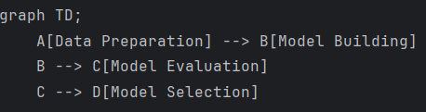
Predictive Analysis (Classification)
The process of building, evaluating, improving, and finding the best performing classification model involved several key steps. First, the data was prepared by loading, standardizing, and splitting it into training and testing sets. Then, models were built using GridSearchCV for hyperparameter tuning for Logistic Regression, SVM, Decision Tree, and KNN classifiers. The models were evaluated using accuracy scores and confusion matrices. Finally, the best performing model was selected by comparing the accuracy scores of all models.
IBM-Data-Science/spaceX/SpaceX-Machine-Learning-Prediction-Part-5-v1.ipynb at main · gp2001/IBM-Data-Science

Slide 16
Results
Exploratory data analysis results
Interactive analytics demo in screenshots
Predictive analysis results

Slide 17

Section 2

Slide 18
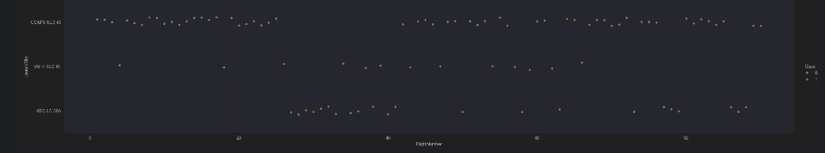
Flight Number vs. Launch Site
The success rate of the launches tends to increase, suggesting improved experience and operational efficiency.

Slide 19
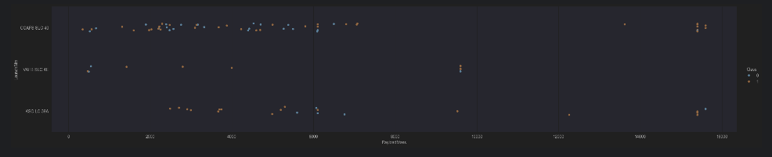
Payload vs. Launch Site
The greater the payload, the higher the success rate.

Slide 20
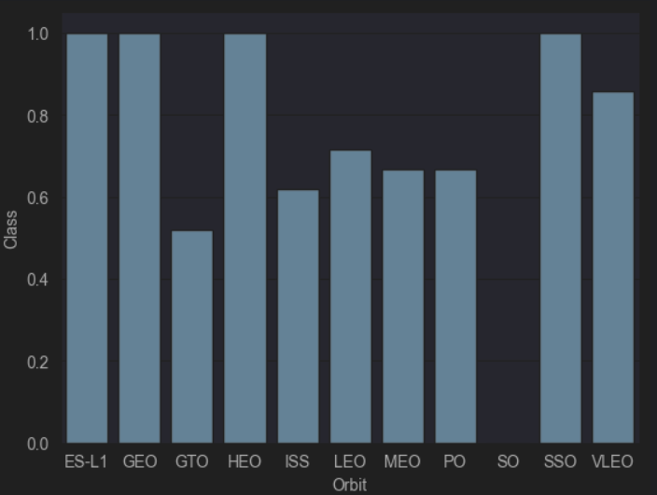
Success Rate vs. Orbit Type
GTO and SO have the worst success rates

Slide 21
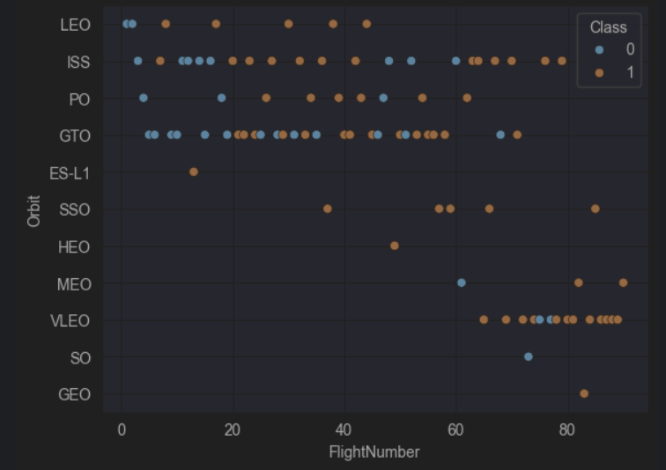
Flight Number vs. Orbit Type
Not much to conclude, looks like more flights -> more success but more research is needed.

Slide 22
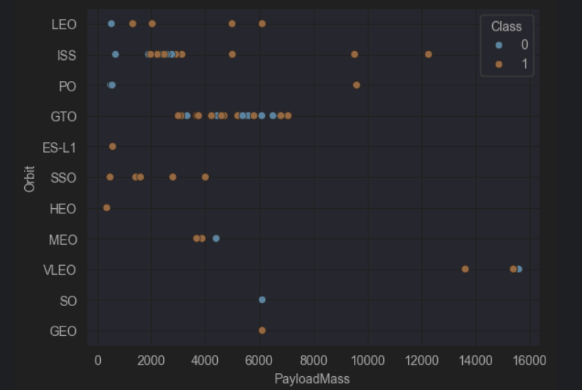
Payload vs. Orbit Type
More successful landings with heavier payloads.

Slide 23
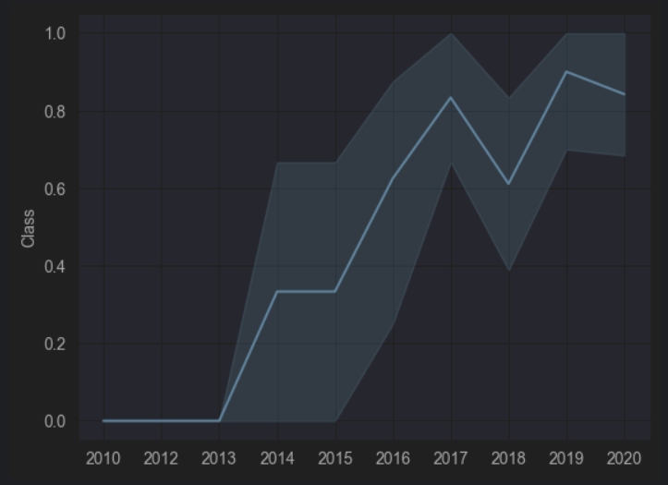
Launch Success Yearly Trend
Succes rate increase till 2019

Slide 24
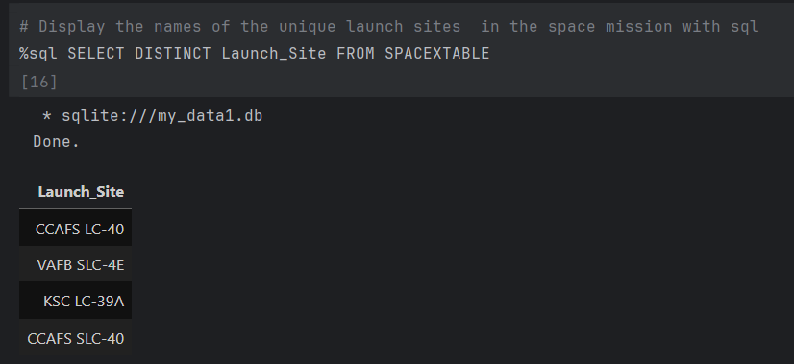
All Launch Site Names
Select all distinct sites

Slide 25
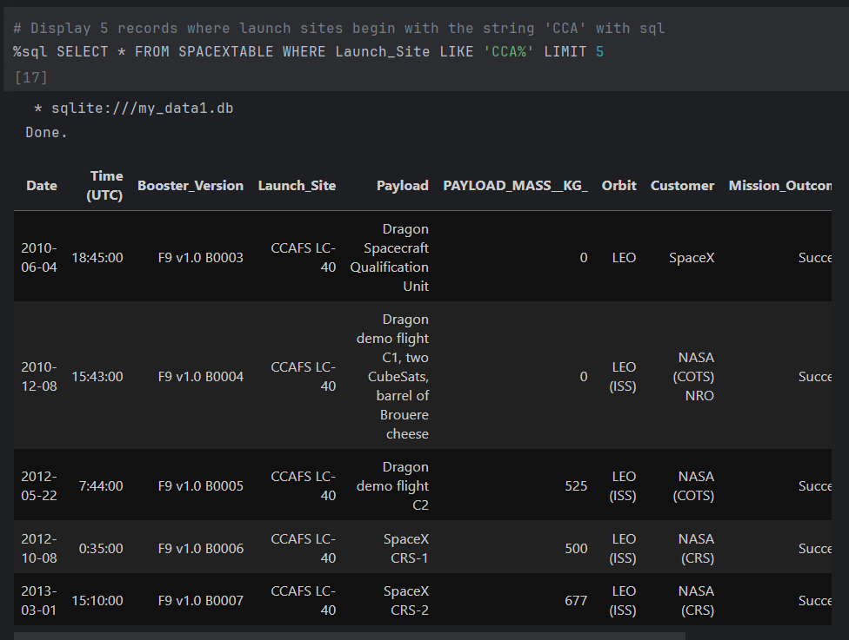
Launch Site Names Begin with 'CCA'
Like is used to retrieve the sites beginning with CCA

Slide 26
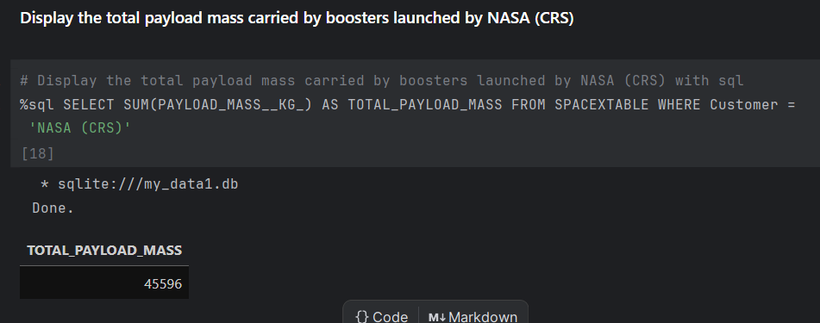
Total Payload Mass
Sum all boosters launched by NASA

Slide 27
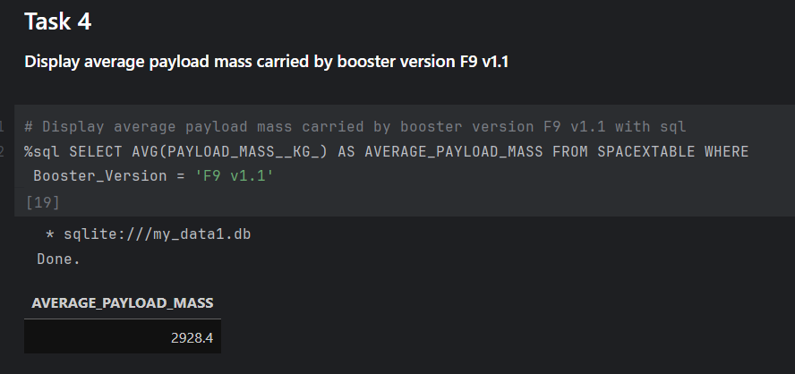
Average Payload Mass by F9 v1.1

Slide 28
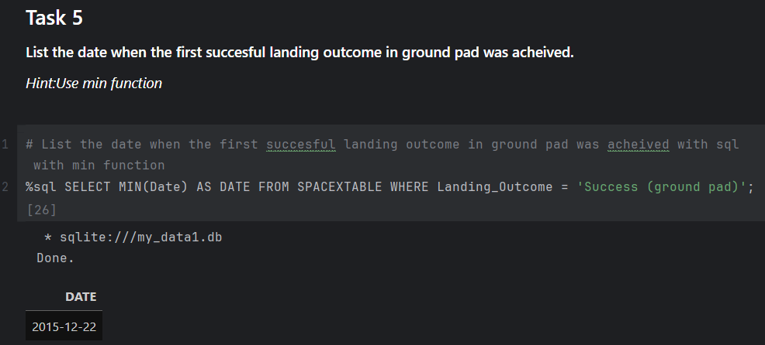
First Successful Ground Landing Date

Slide 29
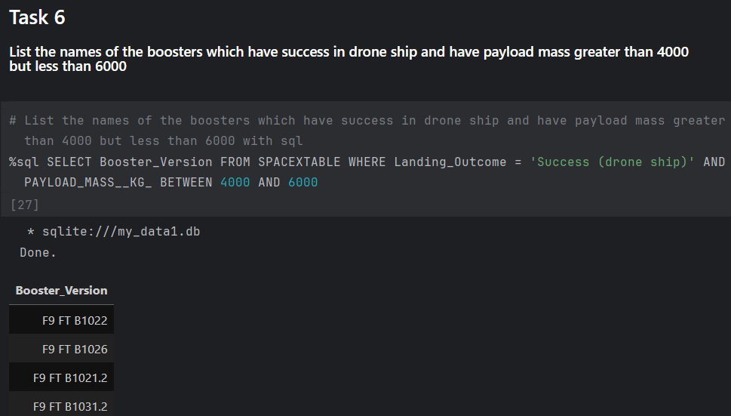
Successful Drone Ship Landing with Payload between 4000 and 6000

Slide 30
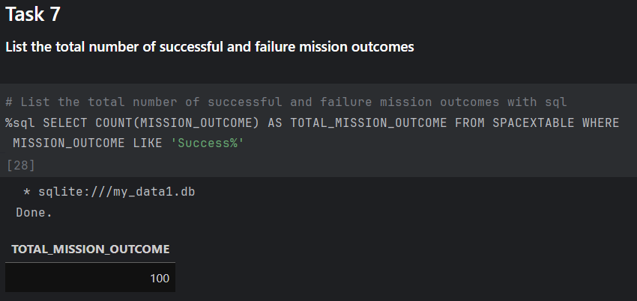
Total Number of Successful and Failure Mission Outcomes

Slide 31
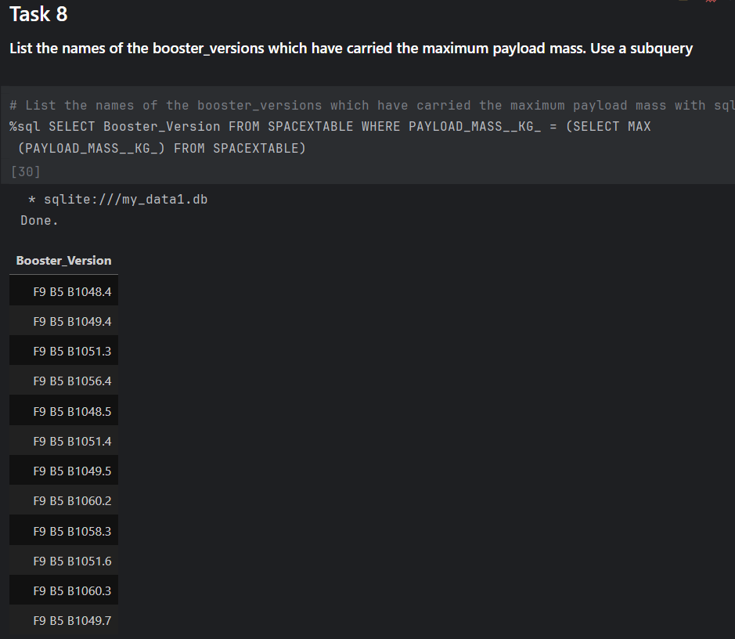
Boosters Carried Maximum Payload

Slide 32
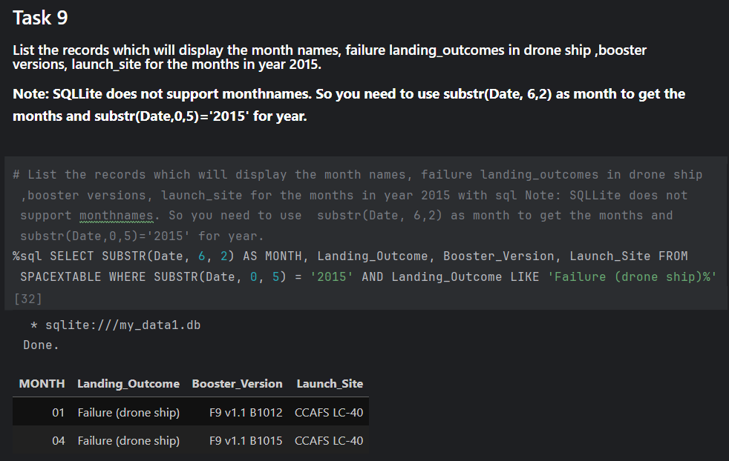
2015 Launch Records
List the failed landing_outcomes in drone ship, their booster versions, and launch site names for in year 2015

Slide 33
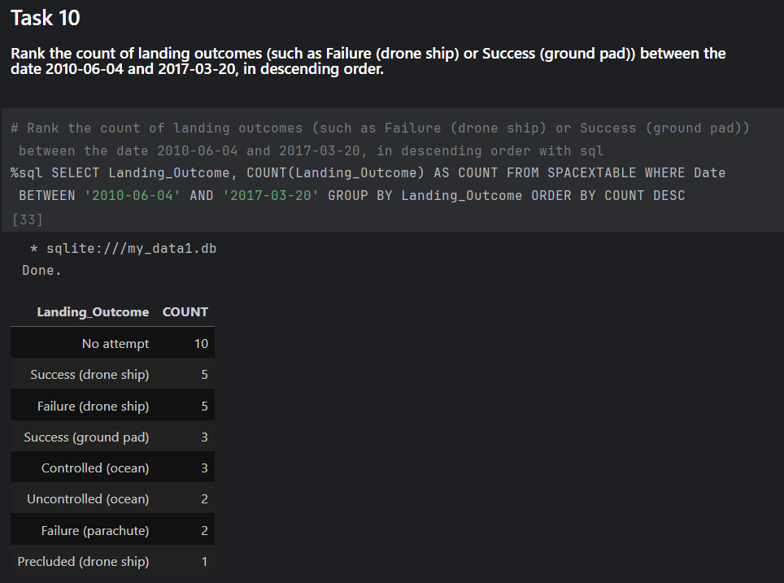
Rank Landing Outcomes Between 2010-06-04 and 2017-03-20
Rank the count of landing outcomes (such as Failure (drone ship) or Success (ground pad)) between the date 2010-06-04 and 2017-03-20, in descending order

Slide 34

Section 3

Slide 35
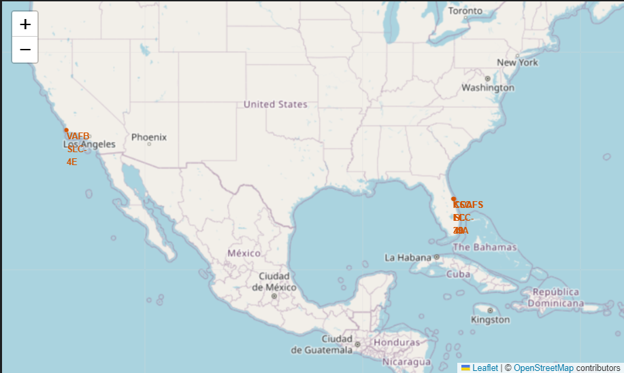
All sites on the map
Florida and California

Slide 36
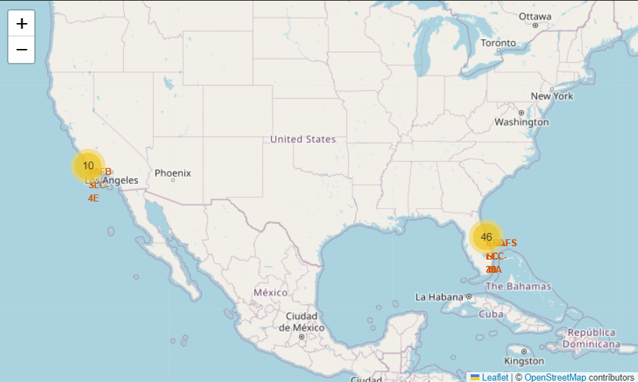
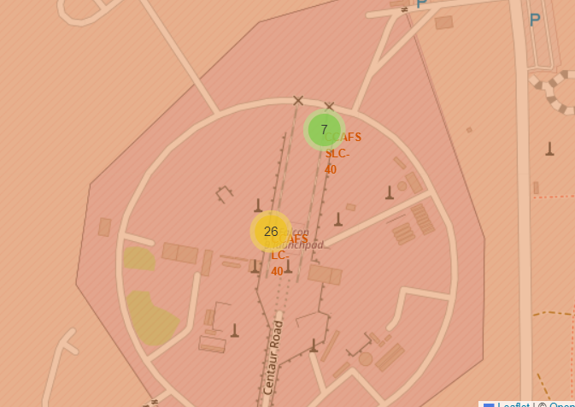
With markers

Slide 37
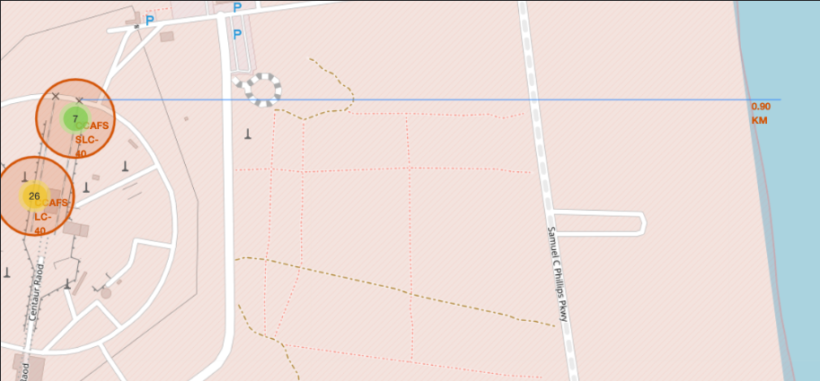
Distance to Coast

Slide 38

Section 4

Slide 39
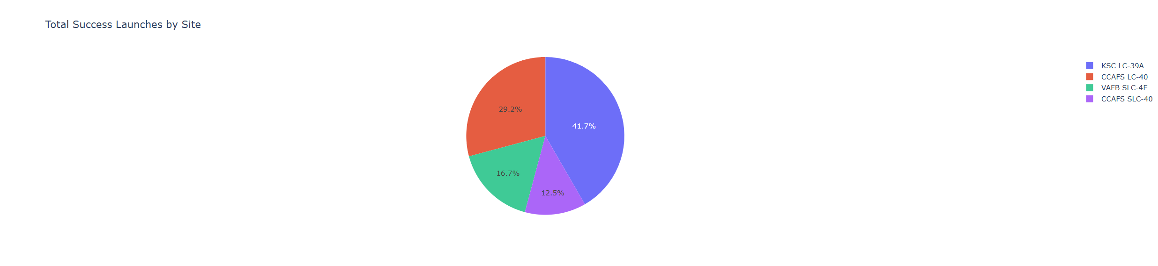
Pie Chart succes rate
KSC has the highest rate

Slide 40
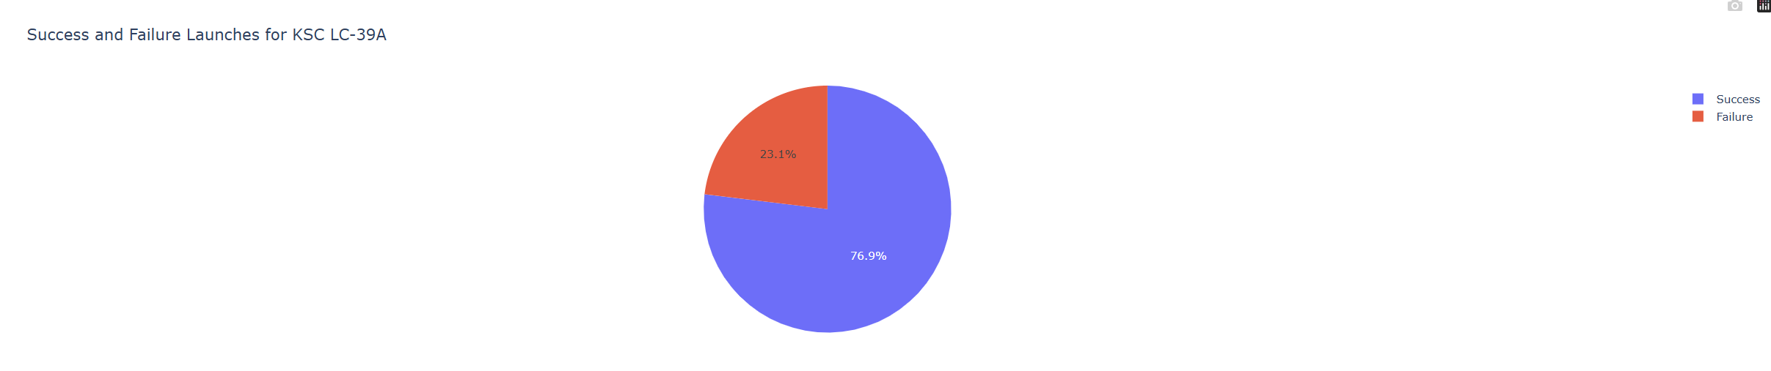
Pie with the highest rate
Highest rate

Slide 41
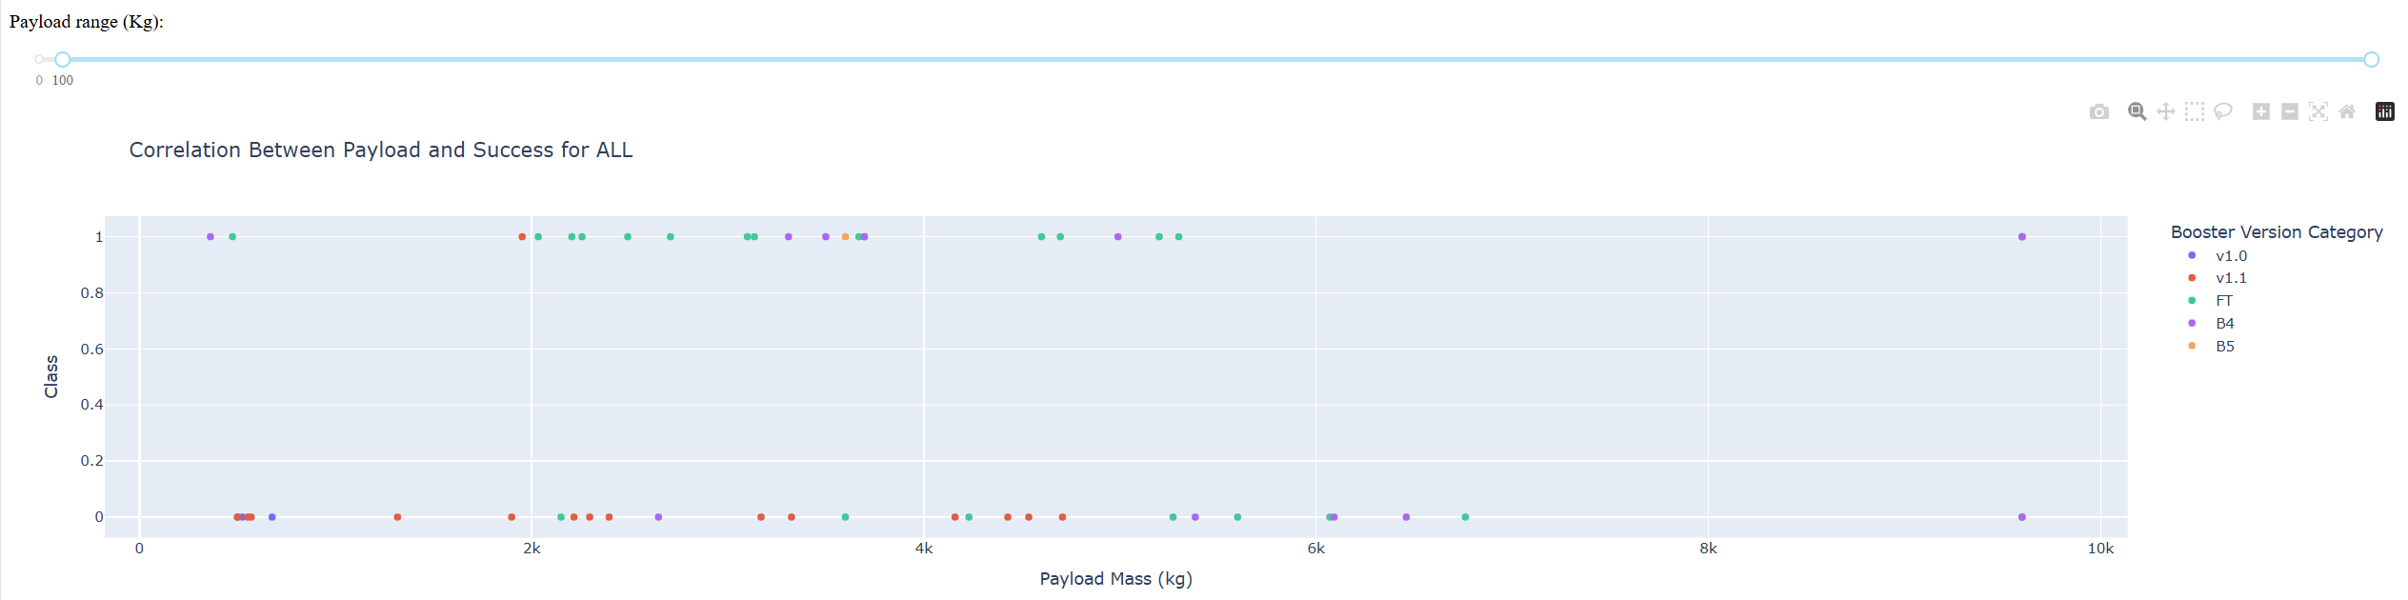
Scatterplot for all sites

Slide 42

Section 5

Slide 43
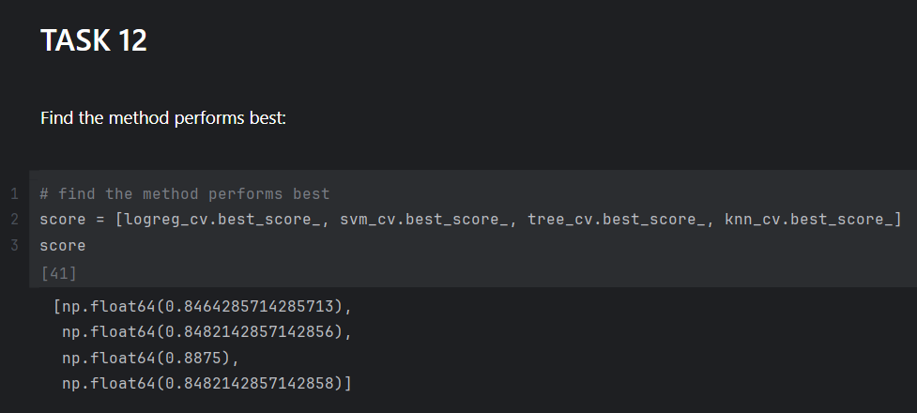
Classification Accuracy
Decision tree has the highest score

Slide 44
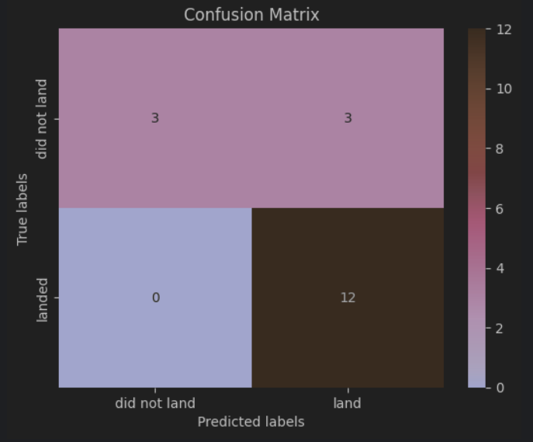
Confusion Matrix
The confusion matrix of the best performing model.

Slide 45
Conclusions
The larger the flight amount at a launch site, the greater the success rate.
Launch success rate increased from 2013 to 2019.
Orbits ES-L1, GEO, HEO, SSO, VLEO had the highest success rates.
KSC LC-39A had the most successful launches.
The Decision Tree classifier is the best algorithm for this task.

Slide 46


